Slide 1


Introduction to Artificial Intelligence
Book: Artificial Intelligence, A Modern Approach (Russell & Norvig)
Ybralem B.

Slide 2

Chapter Two
Intelligent Agents

Slide 3
Contents
Introduction to agent
Agent and Environment
Structure of agents
Intelligent and Rational agent
Types of intelligent agents

Slide 4
Introduction to Agents
An agent is anything that can be viewed as perceiving its environment through sensors and acting upon that environment through actuators.
A human agent has eyes, ears, and other organs for sensors and hands, legs, vocal tract, and so on for actuators.
A robotic agent might have cameras and infrared range finders for sensors and various motors for actuators.
A software agent receives keystrokes, file contents, and network packets as sensory inputs and acts on the environment by displaying on the screen, writing files, and sending network packets.

Slide 5
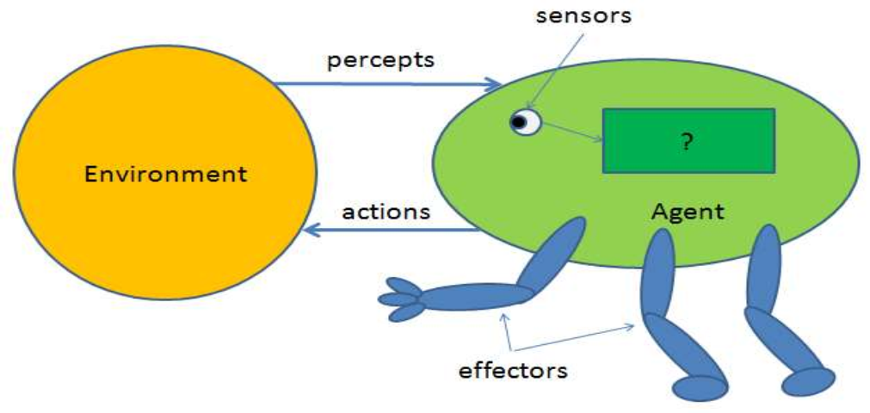
Agent and Environment

Slide 6
Sensors & Effectors
An agent Perceives its environment through sensors.
The complete set of inputs at a given time is called percept.
Percept Sequence is the history of all that an agent has perceived till date.
The current percept, or a sequence of percept can influence the actions of an agent.

Slide 7
…Con
It can change the environment through effectors.
An operation involving an actuator is called an action.
Actions can be grouped in to action sequences.
In general, an agent’s choice of action at any given instant can depend on the entire percept sequence observed to date, but not on anything it hasn’t perceived

Slide 8
Structure of Agents
Agent’s structure can be viewed as −
Agent function → the mapping from percepts sequence to actions. f:P*→A it is an abstract mathematical description of its behavior.
Agent program → Agent program is an implementation of agent function. An agent program executes on the physical architecture to produce function f.
Architecture → the machinery/computing device (e.g. PC, robotic car) with physical sensors and actuators that an agent program will runs on.
Agent = Architecture + Agent Program

Slide 9
Rational Agent
AI is about building rational agents.
A rational agent always does the right thing.
Obviously, doing the right thing is better than doing the wrong thing, but what does it mean to do the right thing? by considering the consequences of the agent’s behavior.
When an agent is plunked down in an environment, it generates a sequence of actions according to the percepts it receives.
This sequence of actions causes the environment to go through a sequence of states.
If the sequence is desirable, then the agent has performed well. This notion of desirability is captured by a performance measure that evaluates any given sequence of environment states.

Slide 10
Rational Agent
Performance Measure is the criteria, which determines how successful an agent is.
It acts in a way to maximize its performance measure with all possible actions.
What is rational at any given time depends on four things:-
  Performance measure that defines the criteria of success
  Agent prior knowledge of its environment
  The actions that the agent can perform
  Agent percept sequence to date

Slide 11
…
This leads to a definition of a rational agent:
  For each possible percept sequence, a rational agent should select an action that is expected to maximize its performance measure, given the evidence provided by the percept sequence and whatever built-in knowledge the agent has.

Slide 12
Intelligent Agents
An intelligent agent is an autonomous entity which act upon an environment using sensors and actuators for achieving goals. An intelligent agent may learn from the environment to achieve their goals.
Intelligent Agent:
    must sense,
    must act,
    must be autonomous(to some extent)
    must be rational.

Slide 13
Task environment
To design a rational agent, we need to specify a task environment
  a problem specification for which the agent is a solution
PEAS: to specify a task environment
  Performance measure
  Environment
  Actuators
  Sensors

Slide 14
PEAS: Specifying an automated taxi driver
Performance measure: what are the desirable qualities that we would aspire from our automated driver?
  safe, fast, legal(minimize violation of traffic laws and other protocols), comfortable, maximize profits, minimize fuel consumption
Environment:
  roads, other traffic, pedestrians, customers
Actuators:
  steering, accelerator, brake, signal, horn
Sensors: Cameras(to see road), sonar and infrared( to detect distances to other cars and obstacles), accelerometer(to control the vehicle properly, especially on curves), speedometer, GPS and engine-fuel-electrical system sensor.

Slide 15
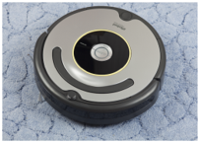
PEAS: Specifying for vacuum cleaner
Performance measure:
  Cleanness, efficiency: distance traveled to clean, battery life, power consumption, cost, speed etc.
Environment:
  Rooms, wood floors, table, dirty, carpet, different obstacles
Actuators:
  Wheel, brushes, vacuum extractor
Sensors:
  cameras, dirt detection sensor, bump sensor, infrared wall sensors.

Slide 16
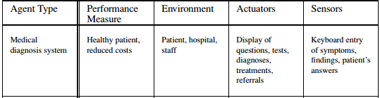
Example of agent environment

Slide 17
Properties of Environments
Fully observable Vs partially observable
  If an agent’s sensors give it access to the complete state of the environment at each point of time, then we say that the task environment is fully observable.
  Fully observable environments are convenient because the agent not need to maintain any internal state to keep track history of the world.
e.g. Chess game, vacuum cleaner
Partially observable: the relevant feature of the environment are only partially observable, because parts of the state are simply missing from the sensor data.
  —Self-driving car

Slide 18
….
Single vs. multi-agent
If only one agent is involved in an environment and operating by itself then such an environment is called single agent environment.
If multiple agents are operating in an environment then such environment is called multi-agent environment.
  For example, an agent solving a crossword puzzle by itself is clearly in a single-agent environment, whereas an agent playing chess is in a two agent environment.

Slide 19
…
Static vs. dynamic
If the environment can change itself while the agent is deliberating then such environment is called dynamic for that agent otherwise it is static.
Static environments are easy to deal with because the agent does not need to keep looking at the world while it is deciding on an action.
However, in dynamic environment agents need to keep looking at the world while it is deciding on an action.
  Tax driving is an example of a dynamic environment whereas crossword puzzle are an example of a static environment.

Slide 20
…
Episodic vs. sequential
In an episodic task environment, the agent’s experience is divided into atomic episodes. Agent performs independent task in each episode.
  The agent current decision doesn’t affect future decisions.
  Many classification tasks are episodic.
  For example, an agent that has to spot defective products on an assembly line bases each decision on the current part, regardless of previous decisions.

Slide 21
…
In sequential environments the agent operates in the series of connected episode.
  The agents the current decision could affect all future decisions.
  Chess and taxi driving are sequential: in both cases, short-term actions can have long-term consequences.

Slide 22
…
Deterministic vs. stochastic
If an agent's current state and selected action can completely determine the next state of the environment, then such environment is called deterministic environment.
A stochastic environment is random in nature and cannot be determined completely by an agent.
  Taxi driving is clearly stochastic in this sense, because one can never predict the behavior of traffic exactly. Chess is example of deterministic.

Slide 23
…
Discrete vs. continuous
If in an environment there are a finite number of percepts and actions that can be performed within it, then such an environment is called a discrete environment else it is called continuous environment.
  For example, the chess comes under discrete environment because it has a finite number of distinct states, and discrete set of percepts and actions.
  Taxi driving is a continuous-state and continuous-time problem: the speed and location of the taxi is continuous values.

Slide 24
…..
Known vs unknown describes how well the designer of the intelligent agent knows the environment.
In known environment the outcome for all actions are given.
  Example: solitaire card games
If the environment is unknown, the agent will have to learn how It works in order to make good decisions.
  Example: new video game but I still don’t know what the buttons do until I try them.

Slide 25
Summary
Characteristic | Simple Environment | Difficult/hardest Environment
Deterministic/stochastic | Deterministic | Stochastic
Observability | Fully observable | Partially observable
Static/Dynamic | Static | Dynamic
Discrete/continuous | Discrete | Continuous
Known/Unknown | Known | Unknown
Single/Multiple Agents | Single agent | Multiple agents
Taxi driving is hard in all these senses, except that for the most part the driver’s environment is known. Driving a rented car in a new country with unfamiliar geography and traffic laws is a lot more exciting.

Slide 26
Types of Intelligent Agents
Intelligent agents are grouped in to five classes based on their degree of perceived intelligence and capability.
  Simple reflex agents
  Model based reflex agents
  Goal based agents
  Utility based agents
  Learning agents

Slide 27
Simple reflex Agents
Simple reflex agents take decision on the basis of the current percept, ignoring the rest of the percept history.
It works on the condition-action rule:-which means it directly maps the current state to action.
  For example: If car in front is braking and its brake lights come on.” Then, this triggers some established connection in the agent program to the action “initiate braking” .
  Vacuum cleaner works based on the current perception and action rule.
  Humans also do such action that is the reflex action.
We call such a connection, condition–action rule, written as
if car-in-front-is-braking then initiate-braking.
This agents only succeed in the environment is fully observable.

Slide 28
…
Problems are:
    Very limited intelligence.
    No knowledge of non-perceptual parts of state.
    Usually too big to generate and store.
    If there occurs any change in the environment, then the collection of rules need to be updated.

Slide 29
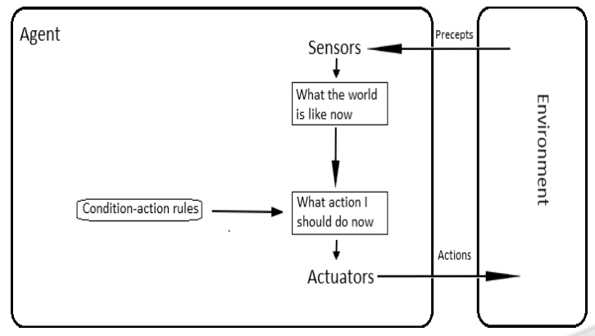
…..
Figure: schematic diagram of simple reflex Agents

Slide 30
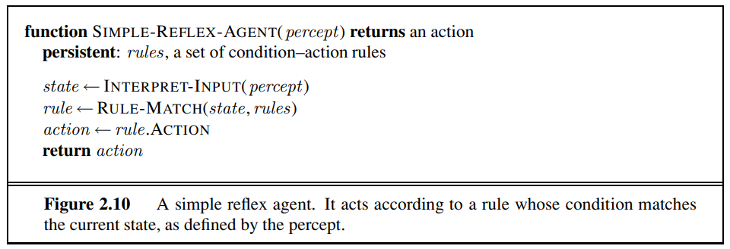
…..
INTERPRET-INPUT function generates an abstracted description of the current state from the percept.
RULE-MATCH function returns the first rule in the set of rules that matches the given state description.

Slide 31
Model based reflex agents
A model-based agent can handle a partially observable environment.
Needs memory for storing the percept history, it uses the percept history to help revealing the current unobservable aspects of the environment (internal state).
E.g.
For the braking problem, the internal state is-
  Just the previous frame from the camera, allowing the agent to detect when two red lights at the edge of the vehicle go on or off simultaneously.
For changing lanes,
  The agent needs to keep track of where the other cars are if it can’t see them all at once (to avoid collision).

Slide 32
…
The agent combines current percept with the internal state to generate updated description of the current state.
Updating the state requires information about :
  how the world evolves in-dependently from the agent
    E.g. that an overtaking car generally will be closer behind than it was a moment ago.
  how the agent actions affects the world.
    E.g. when the agent turns the steering wheel clockwise, the car turns to the right, or that after driving for five minutes northbound on the freeway, one is usually about five miles north of where one was five minutes ago.

Slide 33
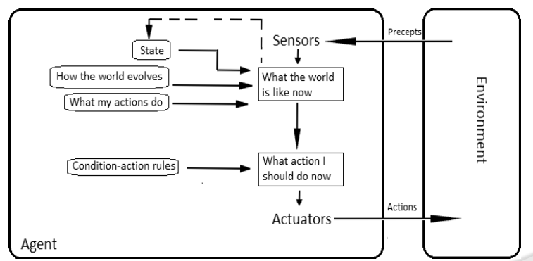
…..
Figure: Model based reflex agents:
showing how the current percept is combined with the old internal state to generate the updated description of the current state

Slide 34
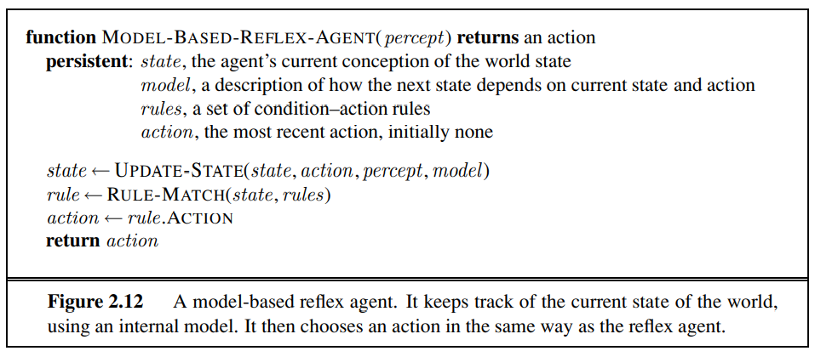
…

Slide 35
Goal based agents
Goal-based agents further expand on the capabilities of the model-based agents, by using "goal" information.
Goal information describes situations that are desirable.
This allows the agent a way to choose among multiple possibilities, selecting the one which reaches a goal state.
Search and planning are the subfields of artificial intelligence devoted to finding action sequences that achieve the agent's goal.

Slide 36
…
Knowing something about the current state of the environment is not always enough to decide what to do.
For example, at a road junction, the taxi can turn left, turn right, or go straight on.
  The correct decision depends on where the taxi is trying to get to.
  In other words, as well as a current state description, the agent needs some sort of “goal information” that describes situations that are desirable.
  This allows the agent a way to choose among multiple possibilities, selecting the one which reaches a goal state.
  The agent program can combine “goal information” with the “model” to choose actions that achieve the goal.

Slide 37
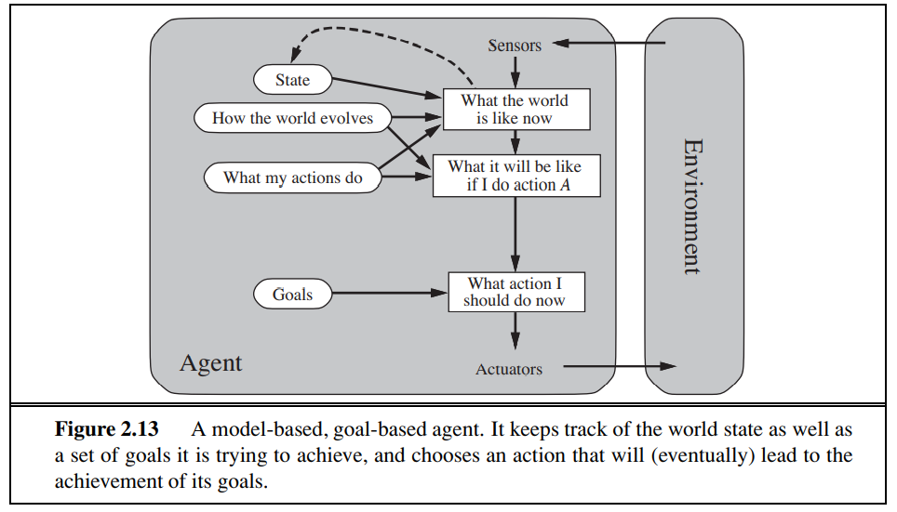
…..

Slide 38
Utility based agents
Goal-based agents only distinguish between goal states and non-goal states.
It is possible to define a measure of how desirable a particular state is.
This measure can be obtained through the use of a utility function which maps a state to a measure of the utility of the state.
A more general performance measure should allow a comparison of different world states according to exactly how happy they would make the agent. The term utility, can be used to describe how "happy" the agent is.

Slide 39
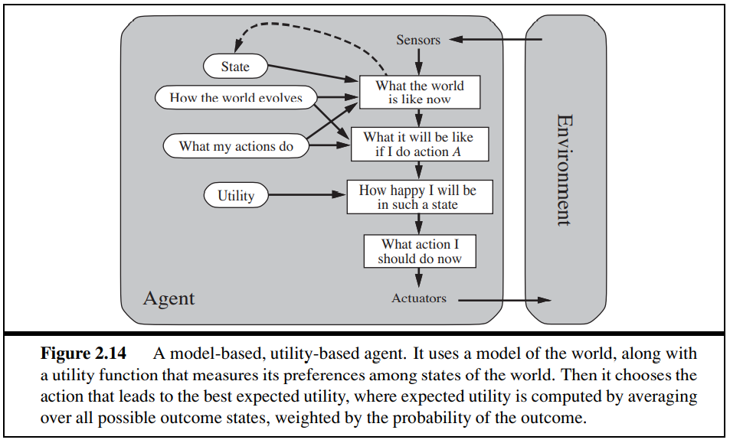
….

Slide 40
Learning agents
Learning has an advantage that it allows the agents to initially operate in unknown environments and to become more competent than its initial knowledge alone might allow.
four conceptual components:
  Critic
    Passes information to learning how the agent is doing that helps to determine how the performance element should be modified to do better in the future.
    Tells the learning element how well the agent is doing with respect to a fixed performance standard.
  Learning Element
    is responsible for making improvements
  Problem Generator
    The last component of the learning agent is the "problem generator". It is responsible for suggesting actions that will lead to new and informative experiences.
  Performance Element
    is responsible for selecting external actions.

Slide 41
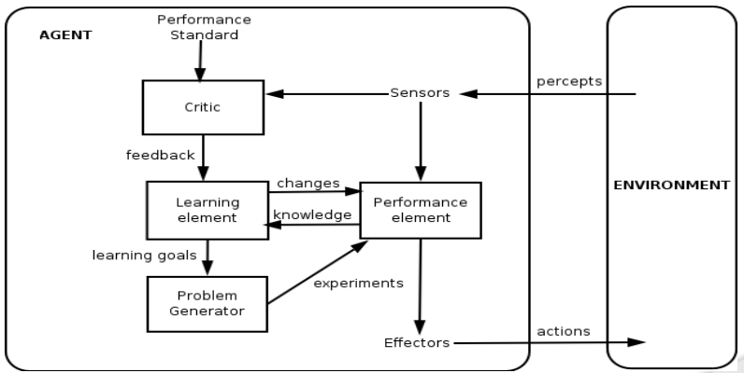
….

Slide 42
Con…
E.g. automate taxi: using Performance element the taxi goes out on the road and drives. The critic observes the shocking language used by other drivers. From this experience, the learning element is able to formulate a rule saying this was a bad action, and the performance element is modified by installing new rule. The problem generator might identify certain areas in need of improvement, such as trying out the brakes on different roads under different conditions.

Slide 43
END

